Slide 1
Interrupt

Slide 2
Introduction
Interrupt is a process where an external device can get the attention of the microprocessor.
  The process starts from the I/O device
  The process is asynchronous.
Interrupts can be classified into two types:
  Maskable(can be delayed)
  Non-Maskable(can not be delayed)
• Interrupts can also be classified into:
  Vectored(the address of the service routine is hard-wired)
  Non-vectored(the address of the service routine needs to be supplied externally)

Slide 3
Introduction
An interrupt is considered to be an emergency signal.
  The Microprocessor should respond to it as soon as possible.
  When the Microprocessor receives an interrupt signal, it suspends the currently executing program and jumps to an Interrupt Service Routine(ISR) to respond to the incoming Interrupt.
  Each interrupt will most probably have its own ISR.

Slide 4
Responding to interrupt
Responding to an interrupt may be immediate or delayed depending on whether the interrupt is maskable or non-maskable and whether interrupts are being masked or not.
There are two ways of redirecting the execution to the ISR depending on whether the interrupt is vectored or non-vectored.
  The vector is already known to the Microprocessor
  The device will have to supply the vector to Microprocessor

Slide 5
8085 Interrupt
The maskable interrupt process in the 8085 is controlled by a single flip flop inside the microprocessor.
This Interrupt Enable flip flop is controlled using the two instructions “EI” and “DI”.
• The 8085 has a single Non-Maskable interrupt.
  The non-maskable interrupt is not affected by the value of the Interrupt Enable flip flop.

Slide 6
8085 Interrupt
The 8085 has 5 interrupt inputs.
  The INTR input.
  The INTR input is the only non-vectored interrupt.
  INTR is maskable using the EI/DI instruction pair.
  RST 5.5, RST 6.5, RST 7.5 are all automatically vectored.
  RST 5.5, RST 6.5, and RST 7.5 are all maskable.
  TRAP is the only non-maskable interrupt in the 8085
  TRAP is also automatically vectored

Slide 7
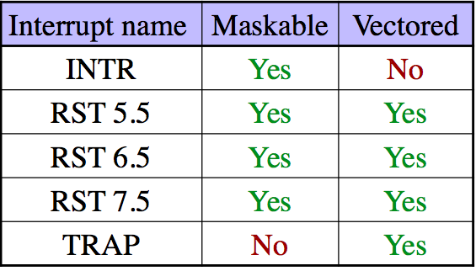
8085 Interrupt

Slide 8
Interrupt Vector
An interrupt vector is a pointer to where the ISR is stored in memory.
All interrupts (vectored or otherwise) are mapped onto a memory area called the Interrupt Vector Table(IVT).
  The IVT is usually located in memory page 00(0000H -00FFH).
  The purpose of the IVT is to hold the vectors that redirect the microprocessor to the right place when an interrupt arrives.
  The IVT is divided into several blocks. Each block is used by one of the interrupts to hold its “vector”

Slide 9

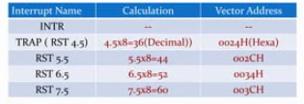

Slide 10
Non-Vectored Interrupt
The interrupt process should be enabled using the EI instruction.
The 8085 checks for an interrupt during the execution of every instruction.
If there is an interrupt, the microprocessor will complete the executing instruction, and start a RESTART sequence.
The RESTART sequence resets the interrupt flip flopand activates the interrupt acknowledge signal (INTA).
Upon receiving the INTA signal, the interrupting device is expected to return the op-code of one of the 8 RST instructions.

Slide 11
Non-Vectored Interrupt
When the microprocessor executes the RST instruction received from the device, it saves the address of the next instruction on the stack and jumps to the appropriate entry in the IVT.
The IVT entry must redirect the microprocessor to the actual service routine.
The service routine must include the instruction EI to re-enable the interrupt process.
At the end of the service routine, the RET instruction returns the execution to where the program was interrupted.

Slide 12
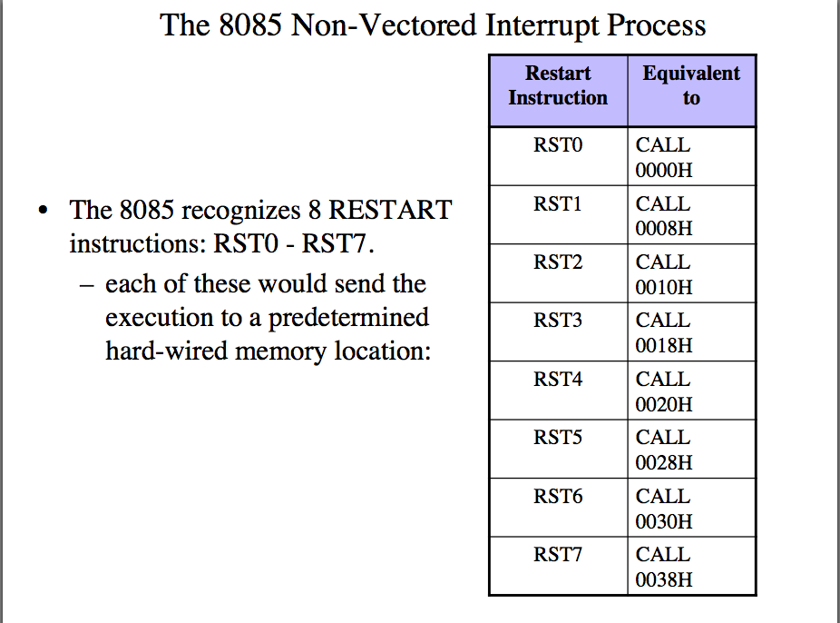

Slide 13
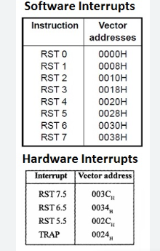


Slide 14
Restart Sequence
The restart sequence is made up of three machine cycles
  In the 1st machine cycle:
    The microprocessor sends the INTA signal.
    While INTA is active the microprocessor reads the data lines expecting to receive, from the interrupting device, the opcode for the specific RST instruction.
  In the 2nd and 3rd machine cycles:
    the 16-bit address of the next instruction is saved on the stack.
    Then the microprocessor jumps to the address associated with the specified RST instruction.

Slide 15
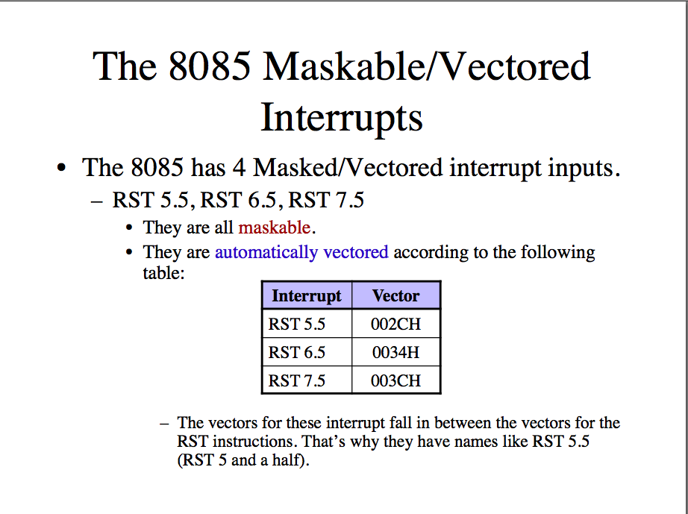

Slide 16
Masking
These three interrupts are masked at two levels:
  Through the Interrupt Enable flip flop and the EI/DI instructions.
    The Interrupt Enable flip flop controls the whole maskable interrupt process.
  Through individual mask flip flops that control the availability of the individual interrupts.
    These flip flops control the interrupts individually.

Slide 17
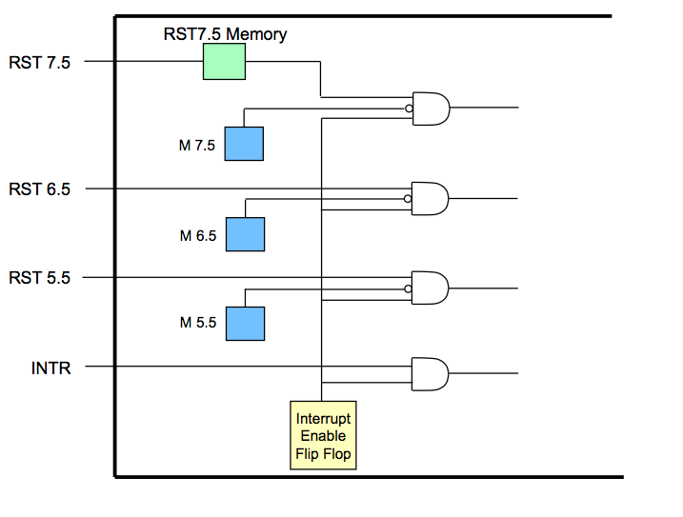
Hardware of EI

Slide 18
Manipulating the Mask
The Interrupt Enable flip flop is manipulated using the EI/DI instructions.
  The individual masksfor RST 5.5, RST 6.5 and RST 7.5 are manipulated using the SIM instruction.
  This instruction takes the bit pattern in the Accumulator and applies it to the interrupt mask enabling and disabling the specific interrupts.

Slide 19
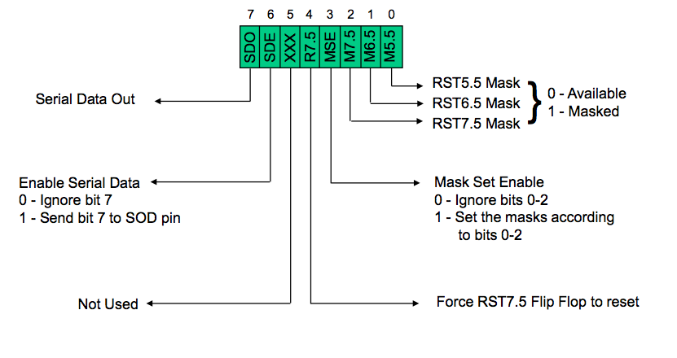
SIM(Set Interrupt Mask)

Slide 20
SIM and Interrupt Mask
Bit 0 is the mask for RST 5.5, bit 1 is the mask for RST 6.5 and bit 2 is the mask for RST 7.5.
  If the mask bit is 0, the interrupt is available.
  If the mask bit is 1, the interrupt is masked.
Bit 3 (Mask Set Enable -MSE) is an enable for setting the mask.
  If it is set to 0 the mask is ignoredand the old settings remain.
  If it is set to 1, the new setting are applied.
The SIM instruction is used for multiple purposes and not only for setting interrupt masks.
  It is also used to control functionality such as Serial Data Transmission.
  Therefore, bit 3 is necessary to tell the microprocessor whether or not the interrupt masks should be modified

Slide 21
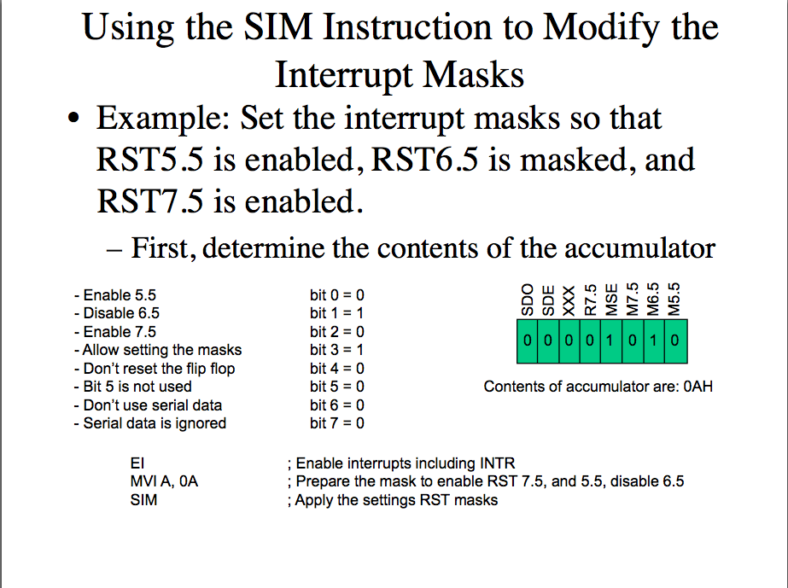

Slide 22
Triggering Level
RST 7.5 is positive edge sensitive.
  When a positive edge appears on the RST7.5 line, a logic 1 is stored in the flip-flop as a “pending” interrupt.
  Since the value has been stored in the flip flop, the line does not have to be high when the microprocessor checks for the interrupt to be recognized.
  The line must go to zero and back to onebefore a new interrupt is recognized.
RST 6.5 and RST 5.5 are level sensitive.
The interrupting signal must remain present until the microprocessor checks for interrupts.

Slide 23
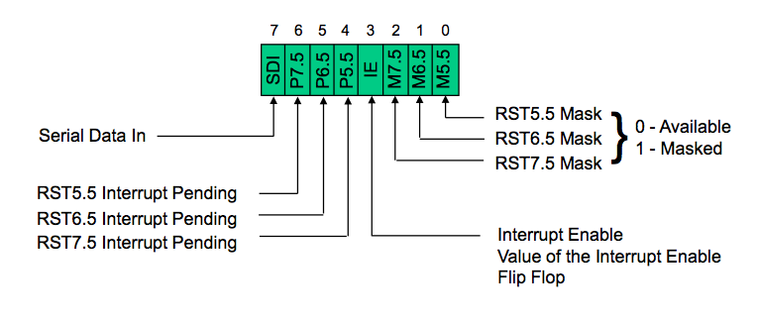
RIM (Read Interrupt Mask)

Slide 24
RIM instruction
Bits 0-2 show the current setting of the mask for each of RST 7.5, RST 6.5 and RST 5.5
  They return the contents of the three mask flip flops.
  They can be used by a program to read the mask settings in order to modify only the right mask.
Bit 3 shows whether the maskable interrupt process is enabled or not.
  It returns the contents of the Interrupt Enable Flip Flop.
  It can be used by a program to determine whether or not interrupts are enabled.

Slide 25
RIM instruction
Bits 4-6 show whether or not there are pending interrupts on RST 7.5, RST 6.5, and RST 5.5
Bits 4 and 5 return the current value of the RST5.5 and RST6.5 pins.
Bit 6 returns the current value of the RST7.5 memory flip flop.
Bit 7 is used for Serial Data Input.
The RIM instruction reads the value of the SID pin on the microprocessor and returns it in this bit.

Slide 26
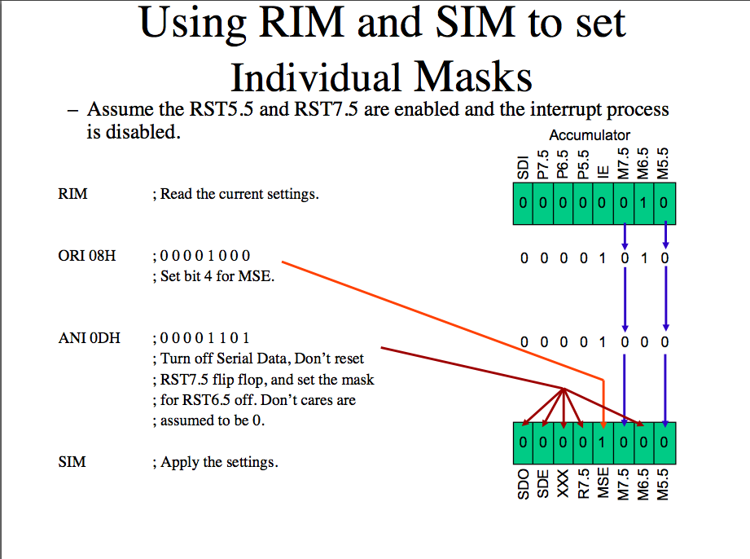

Slide 27
Trap
TRAP is the only non-maskable interrupt.
  It does not need to be enabled because it cannot be disabled.
  It has the highest priority amongst interrupts.
  It is edge and level sensitive.
  It needs to be high and stay high to be recognized. Once it is recognized, it won’t be recognized again until it goes low, then high again.
  TRAP is usually used for power failure and emergency shutoff.

Slide 28
Additional Concepts
Programmable Interrupt Controller 8259 A
  A programmable interrupt managing device
  It manages 8 interrupt requests.
  It can vector an interrupt anywhere in memory without additional H/W.
  It can support 8 levels of interrupt priorities.
The priority scheme can be extended to 64 levels using a hierarchy 0f 8259 device.

Slide 29
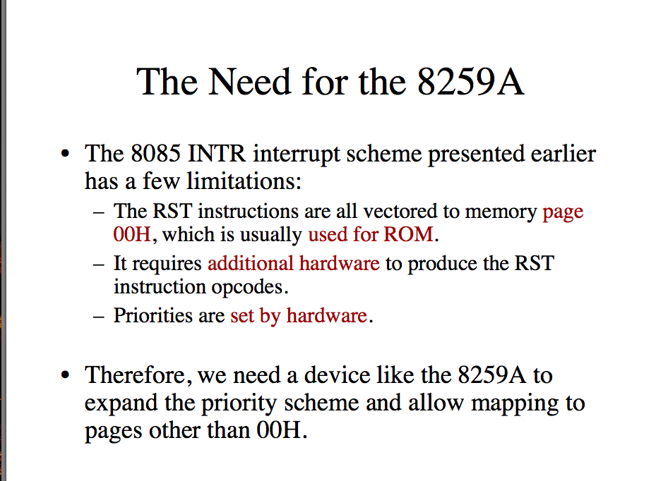

Slide 30
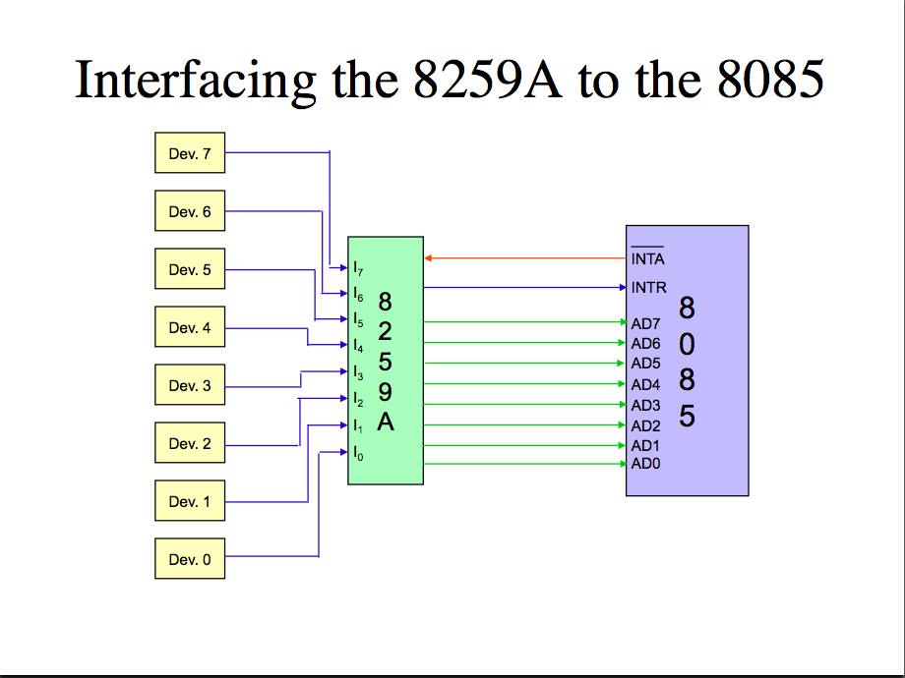

Slide 31
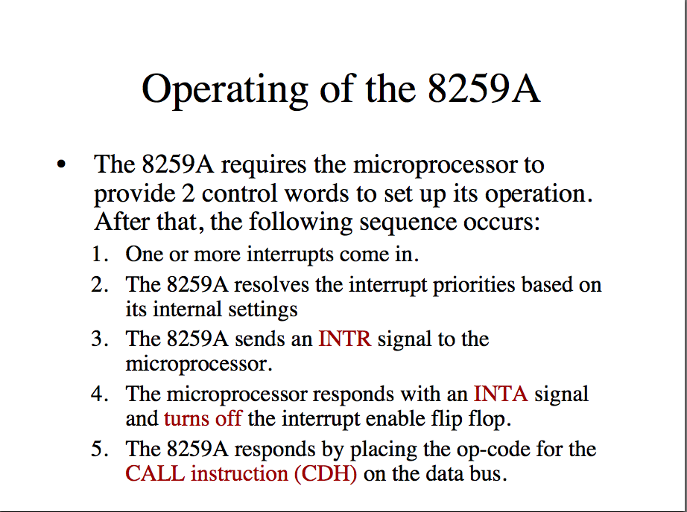

Slide 32
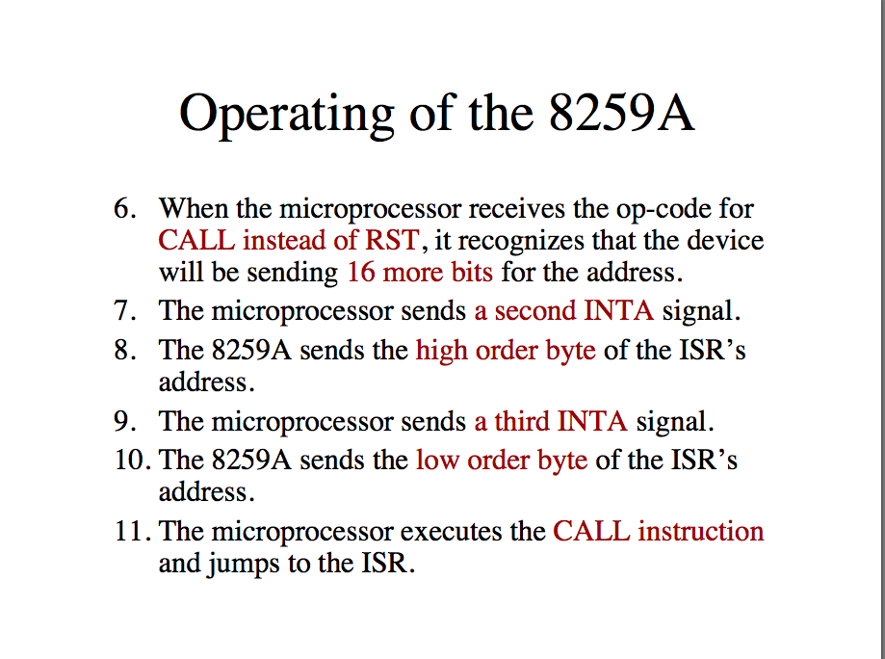

Slide 33
Features
Can manage 8 interrupts
Can be cascaded with another 8259 to increase the interrupts to 64.
Internal priority resolver.
Individually mask each interrupt request.
Read the status of pending , in-service and the masked interrupts

Slide 34
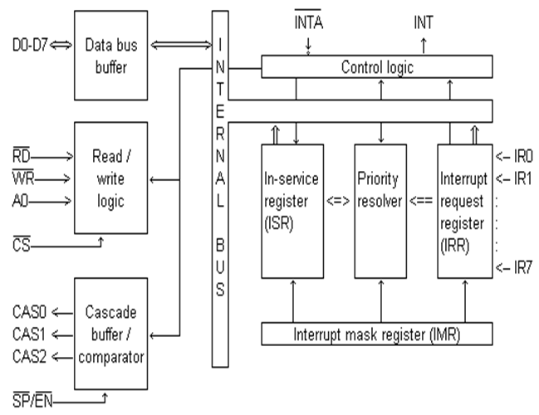
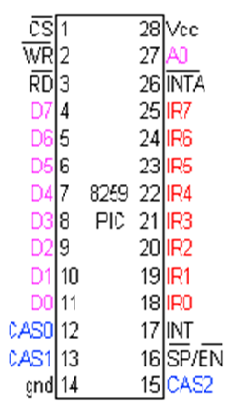
8259 PIC(programmable interrupt controller)

Slide 35
Pin | functions
D0-D7 | Bidirectional tri-stated buffered data lines. connected to data bus directly or through buffers
RD | Active low read control
WR | Active low write control
A0 | Address input line used to select the control register
CS | Active low chip select
CAS0-2 | Bi-directional 3 cascaded lines .In master mode , PIC places slave ID no. on these lines and in slave mode , the PIC reads slave ID no. from master on these lines. It may be regarded as slave select
SP/EN | Slave program/enable. In non buffered mode , it is SP input ,used to distinguish master slave PIC and in buffered mode ,it is output line used to enable the buffer
INT | Interrupt lines, connected to INTR of microprocessor
INTA | Interrupt acknowledge , received active low from microprocessor
IR0-7 | Interrupt request lines generated by peripherals devices

